Slide 1
Why upgrade the FERPA form?
Obtain parent/guardian permission to connect with health care providers and health plans (aka, health insurance companies, Medicaid)
Leverage and use all available resources
Make care coordination easier
Why is care coordination important?
Reduce chronic absenteeism
Improve health status
www.SchoolNurseLink.com

Slide 2
Why are Health Plans valuable partners for schools?
Health plans can…
Get extra services and benefits for children. Many health plans provide specialized case management services which make extra services and benefits to children with chronic health conditions. Incentives, such as gift cards, are often available for families who participate in these case management programs.
Save time for school nurses Health plans can help school nurses:
communicate with physicians and other health care providers,
obtain same-day or next-day transportation,
make appointments with specialists as well as primary care physicians,
make referrals for self-management education or home visit programs
www.SchoolNurseLink.com

Slide 3
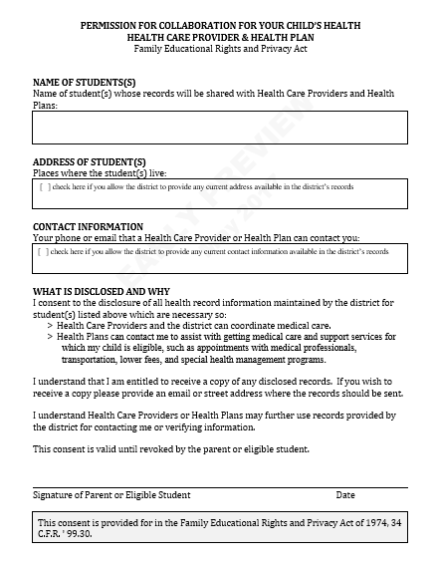
Key Attributes of Template Form
FERPA-compliant
Continuity
Template form permits ongoing care coordination when a student’s health care provider and/or health plan changes
Modifiable
MS Word format allows school districts to make edits, as needed.
www.SchoolNurseLink.com

