Slide 1
www.SchoolNurseLink.com
Why connect with managed Medicaid health plans?
Get extra services and benefits for children.
Save time for school nurses Health plans can help school nurses:
communicate with physicians and other health care providers,
obtain same-day or next-day transportation,
make appointments with specialists as well as primary care physicians,
make referrals for self-management education or home visit programs
New FERPA template available
www.SchoolNurseLink.com
info@SchoolNurseLink.com

Slide 2
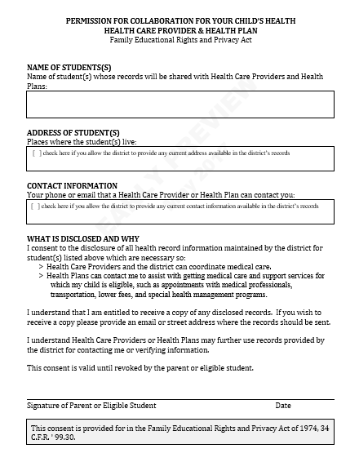
Key Attributes of Template Form
FERPA-compliant
Continuity
Template form permits ongoing care coordination when a student’s health care provider and/or health plan changes
Modifiable
MS Word format allows school districts to make edits, as needed.
www.SchoolNurseLink.com

